Slide 1
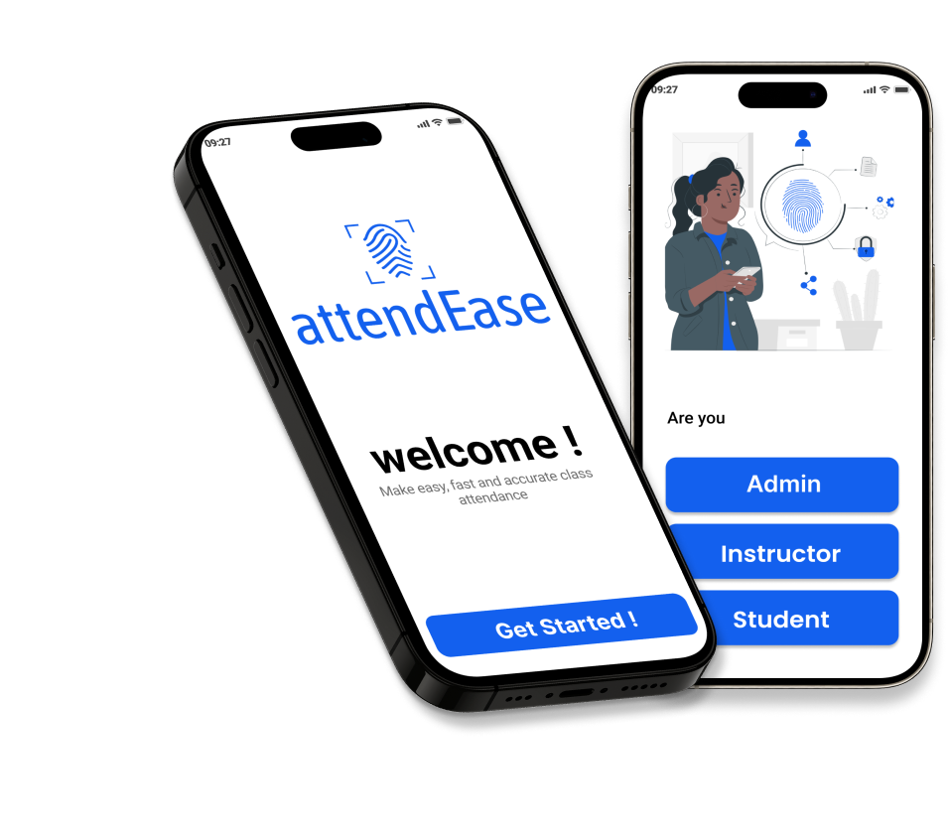

biometric student attendance mobile app
by : group 5

Slide 2


Overview
Introduction
01
about the project
02
analysis and design
03
implementation
04
result
05
challenge and recommendation
06
conclusion
07

Slide 3

Introduction
In today's digital age, the need for efficient and accurate attendance tracking in educational institutions is more critical than ever. The Biometric Student Attendance Mobile Application leverages advanced fingerprint recognition technology to revolutionize attendance management. This innovative app aims to streamline the attendance process, providing a secure, user-friendly, and reliable solution for administrators, teachers, and students.

Slide 4
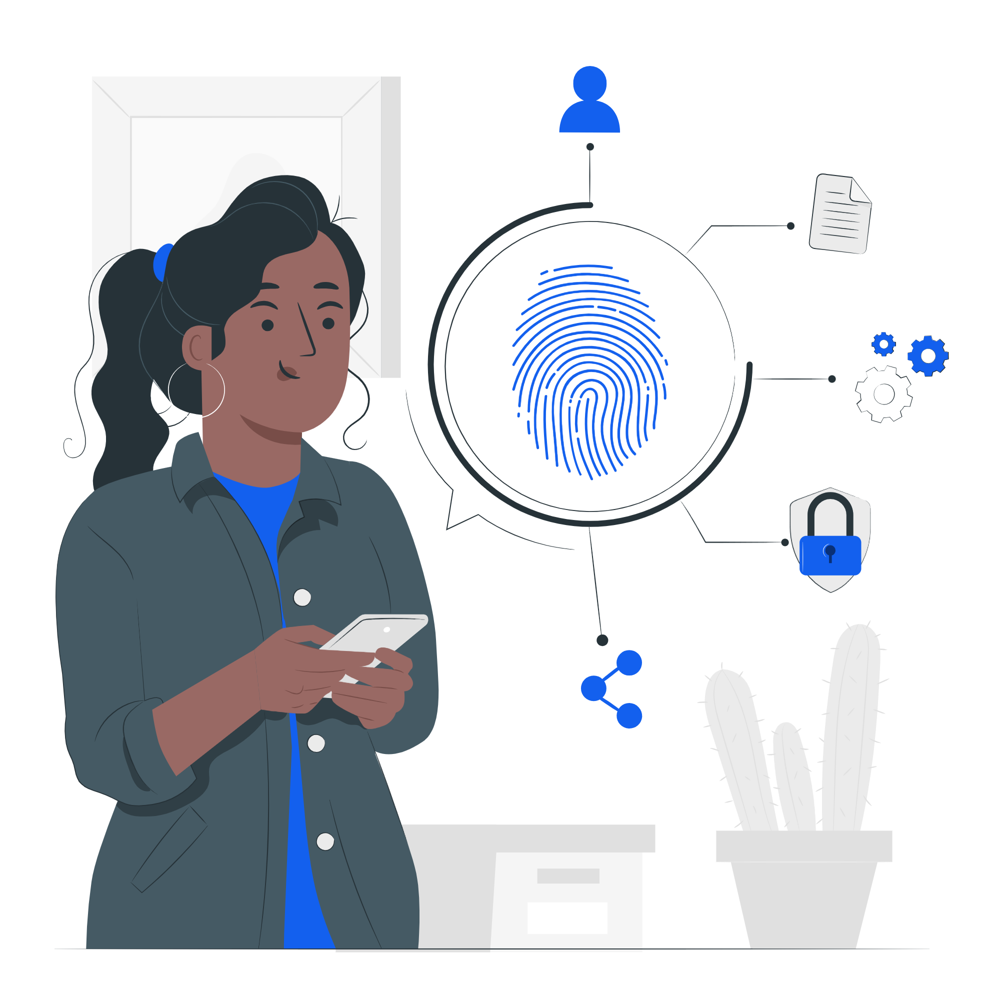
About the project
Specific Objectives
Enhance accuracy
Improve usability
Enable real-time tracking
Increase administrative efficiency
Facilitate integration
Support scalability

Slide 5

Key features
Fingerprint recognition
Automated Attendance reports
Real-time notifications
Data encryptions and privacy compliance.

Slide 6



3. ANALYSIS AND DESIGN
start uml
&
draw.io
figma
google form

Slide 7

Requirement gathering and analysis
Questionnaires and surveys
Interviews
Brainstorming sessions

Slide 8
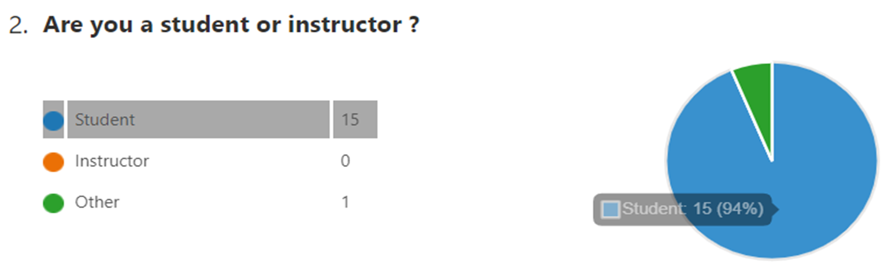
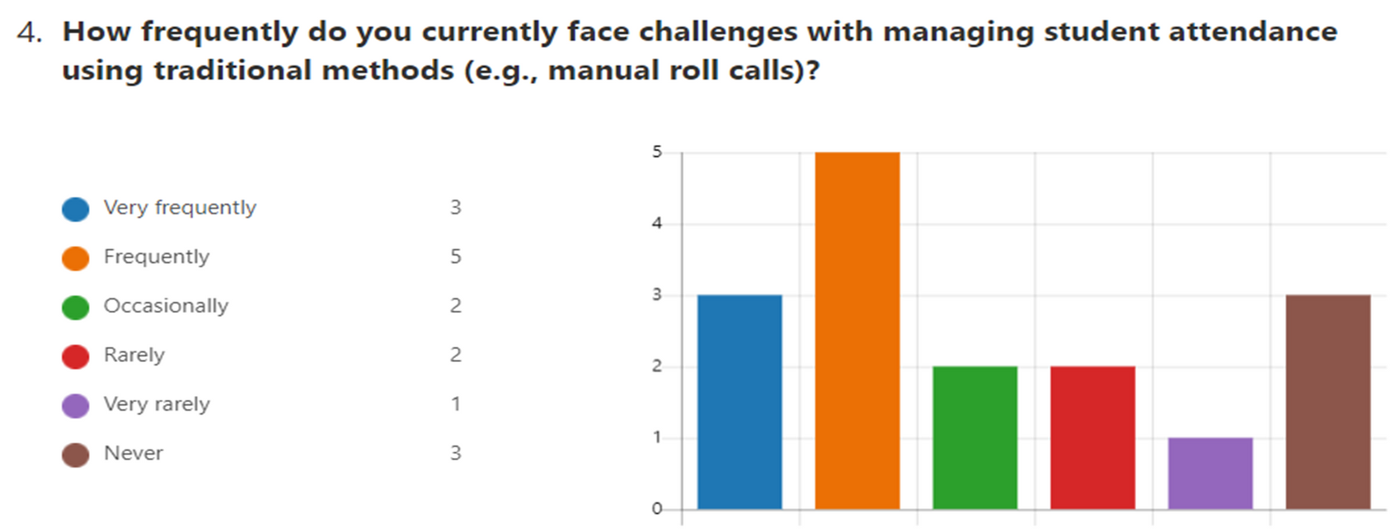

Slide 9
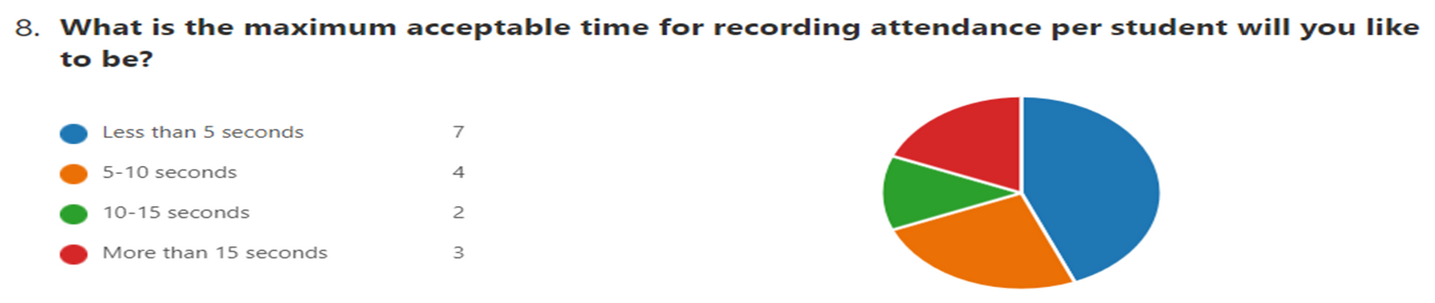
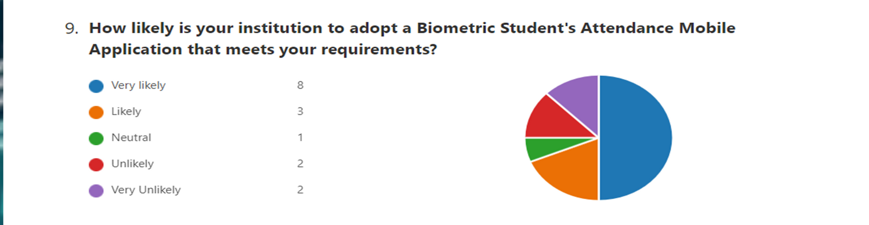

Slide 10
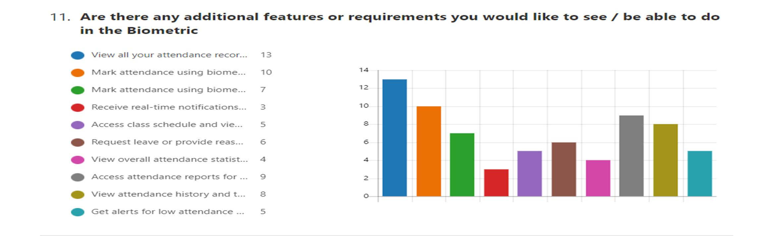

Slide 11

Requiremens
Statistics
Functional Requirement
User management
Attendance marking and data
Biometric authentication
Attendance recording
Database managements
Real-time reporting
80%
10%
Revenue Growth
Return on Investment
20%
Customer Acquisition Cost
Customer Satisfaction

Slide 12

Non functional Requirement
Performance
Usability
Reliability
Security
Maintainability
Portability
Scalability

Slide 13
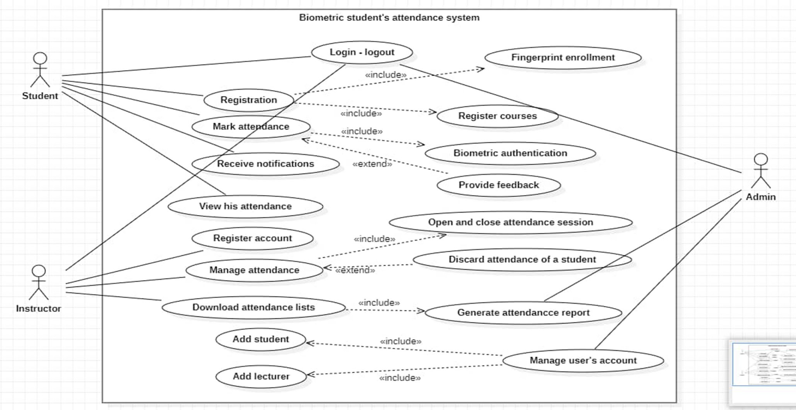
UM Diagrams
USE CASE DIAGRAM

Slide 14
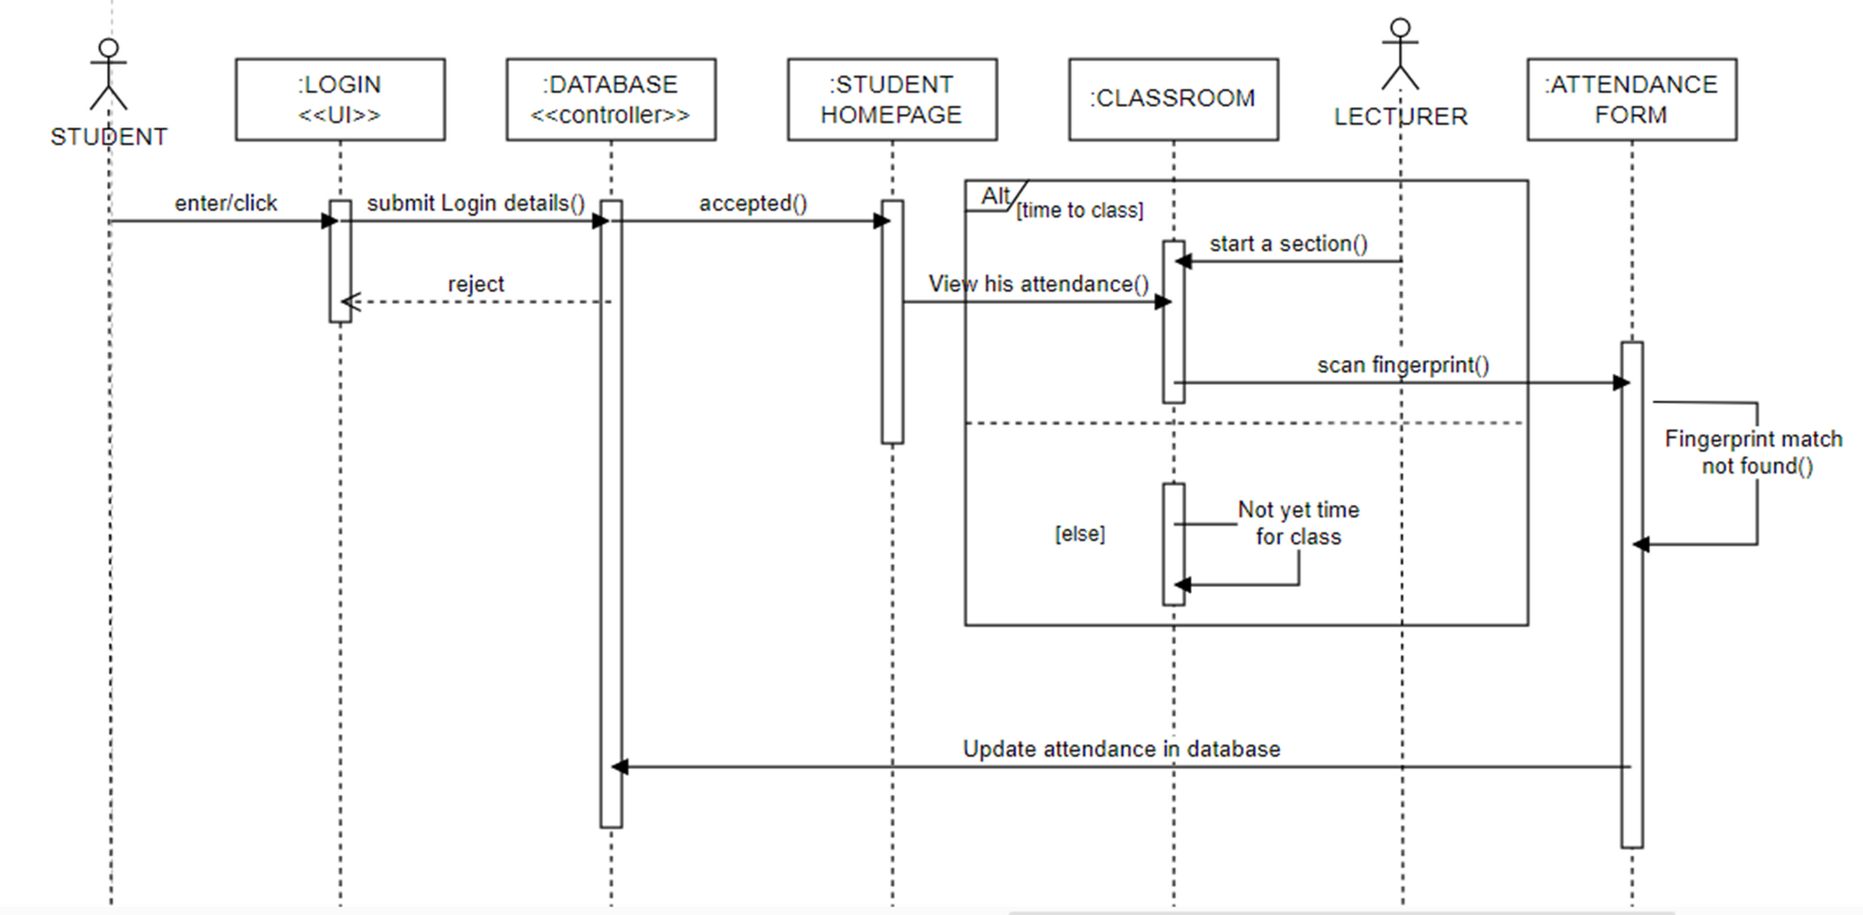
SEQUENCE DIAGRAM

Slide 15
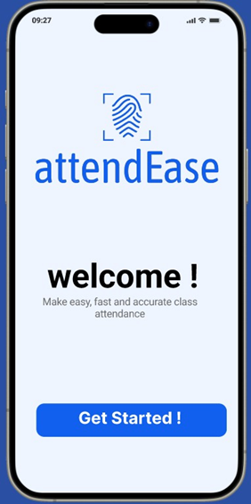
IMPLEMENTATION AND RESULTS
The attendance system recording work flow is dependent on the mobile device students use to sign in for the course currently going on. For this project, we have two delivrables: a mobile application for students and instructors and a web dashboard for the administration.
Mobile Application
To help the students mark their attendance for a course and instructors to manage attendance sessions.
Stack:
React Native
Typescript Stack

Slide 16
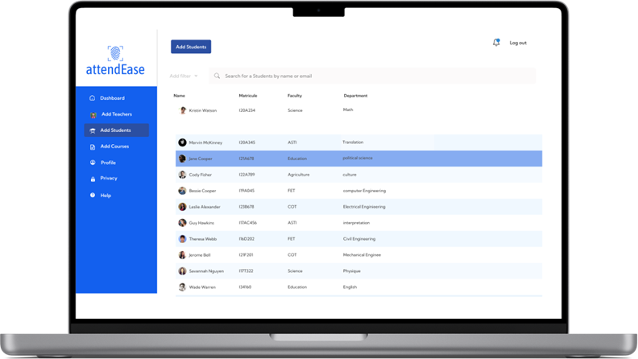
Web dashboard
To help instructors and administration manage staff and students
Stack:
ReactJS
Typescript

Slide 17
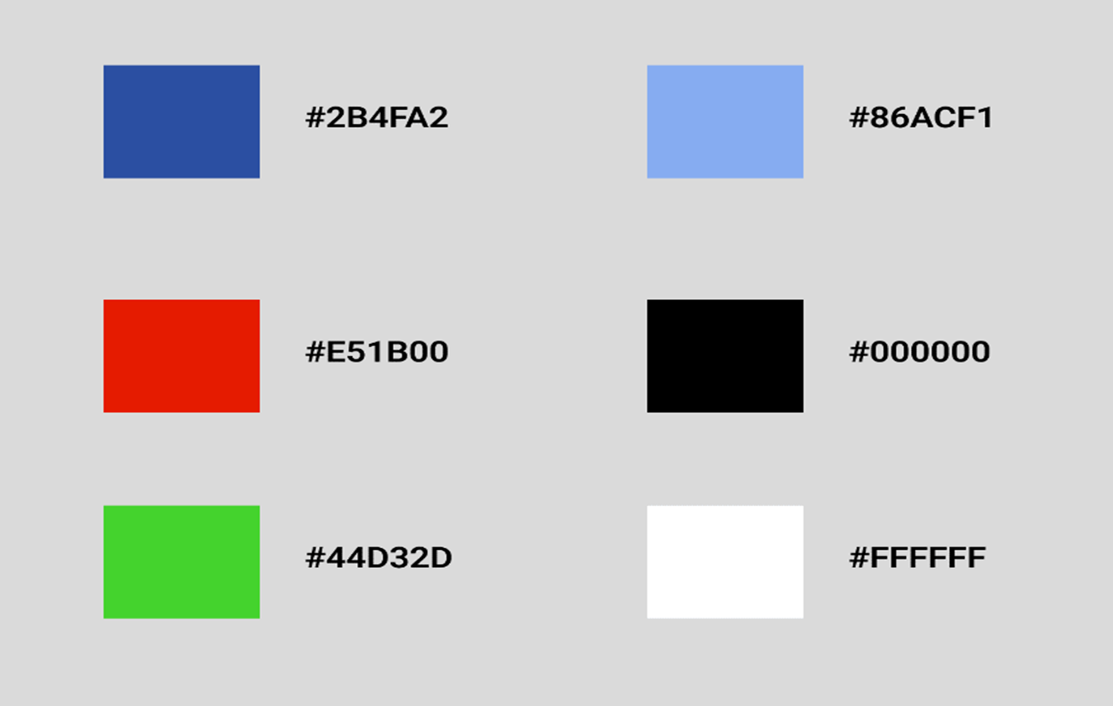
Colors and Typography
Typography: ROBOTO
Blue:
Trust and innovation
Red:
Alerts and danger
Green:
Success
Gray-blue:
Professionalism
Black:
Power and Elegance
White:
Neutrality and Purity

Slide 18
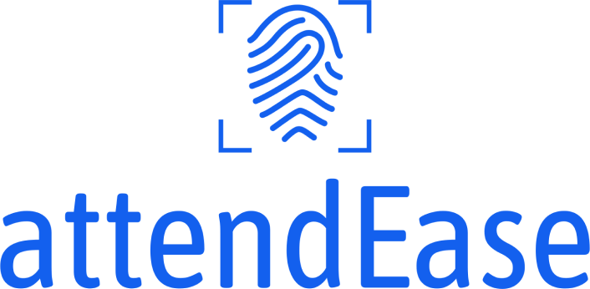
Branding
App name : “Attend Ease”
App significance: Attend Ease is a name for a biometric student attendance system, implying ease and efficiency in managing attendance through fingerprint recognition

Slide 19

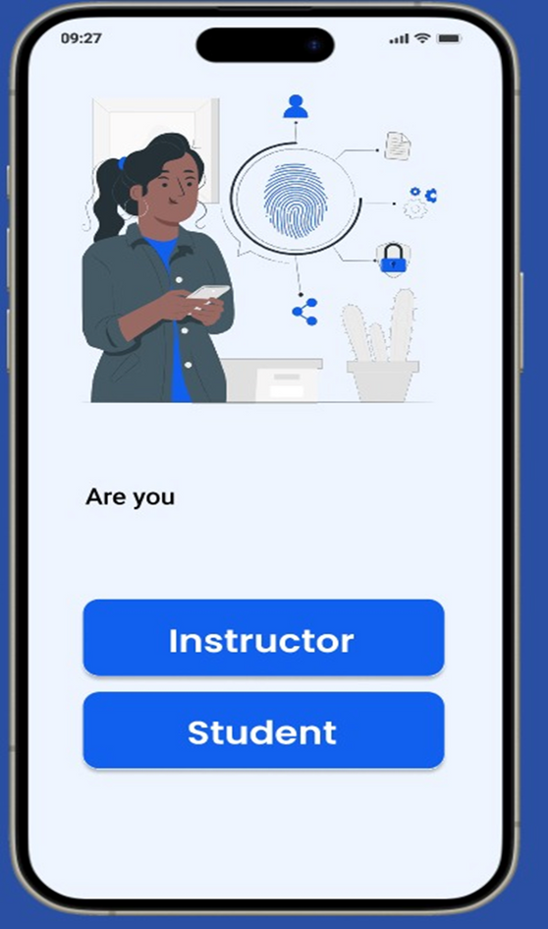
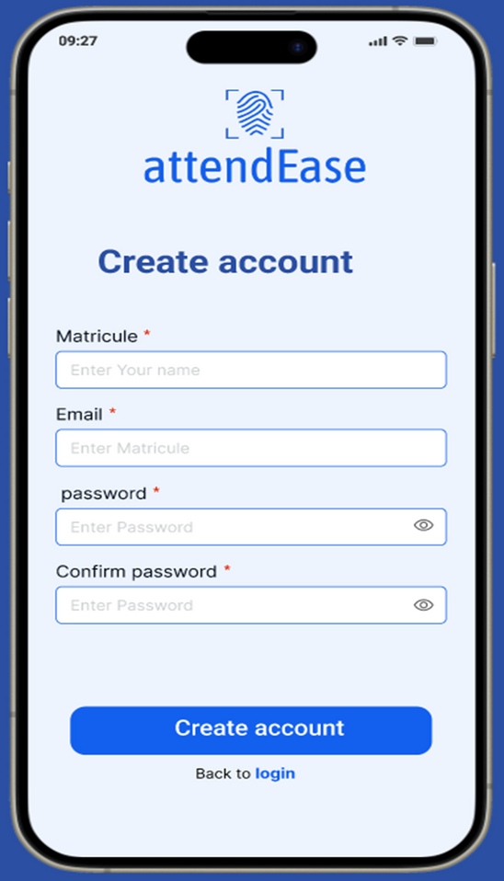
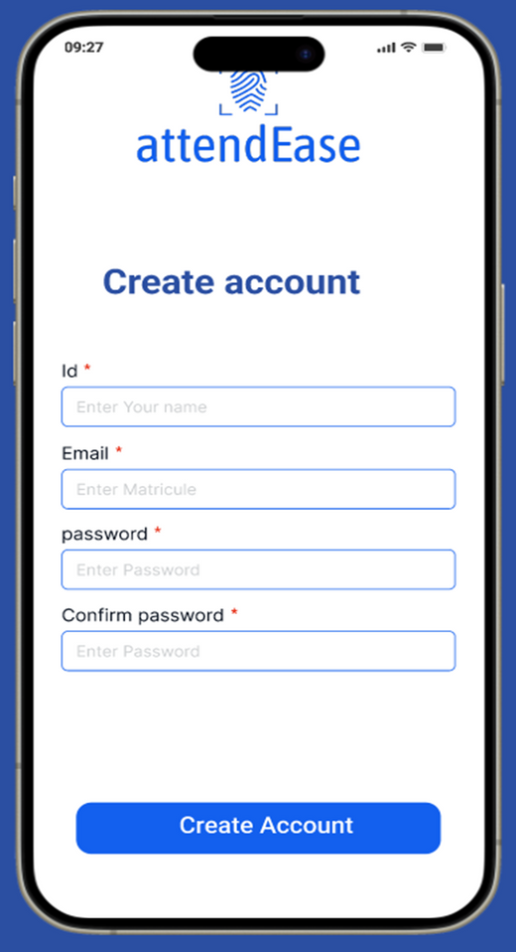
MOBILE APPLICATION SCREENS
Welcome pages
Lecturer and student sign-up pages

Slide 20
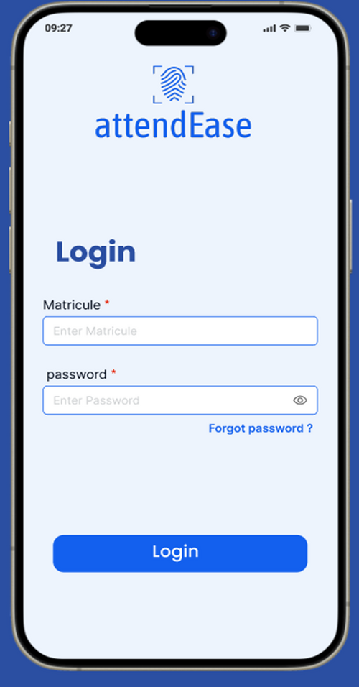
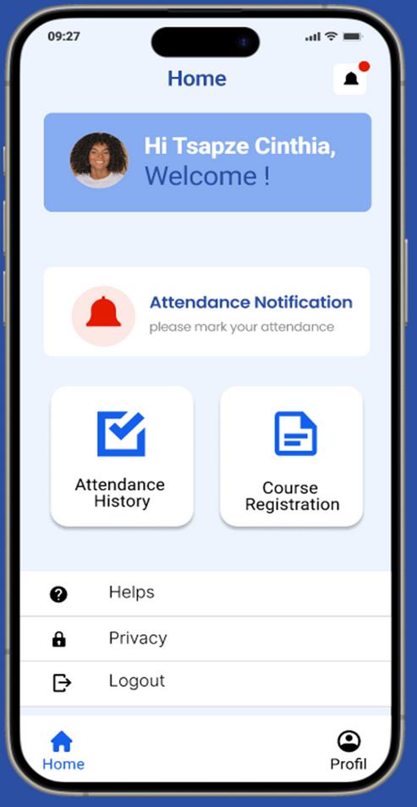
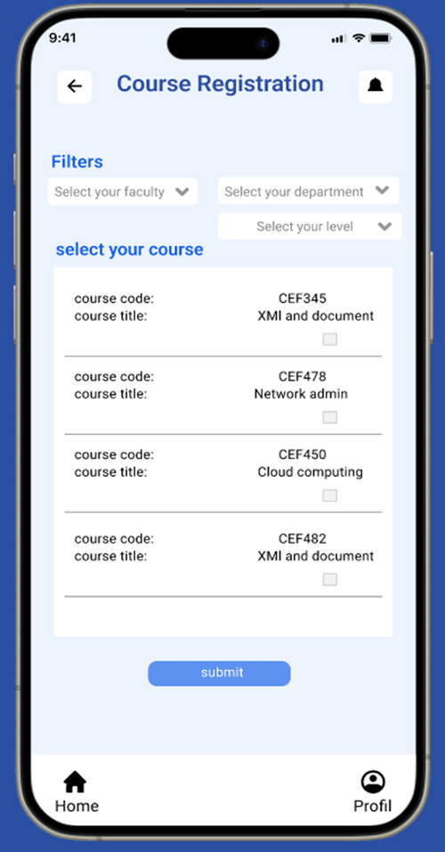
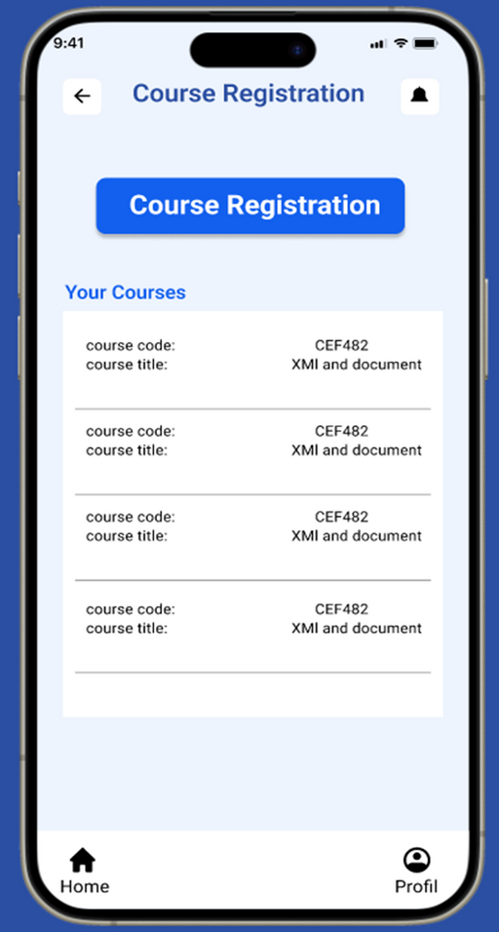
Student pages

Slide 21
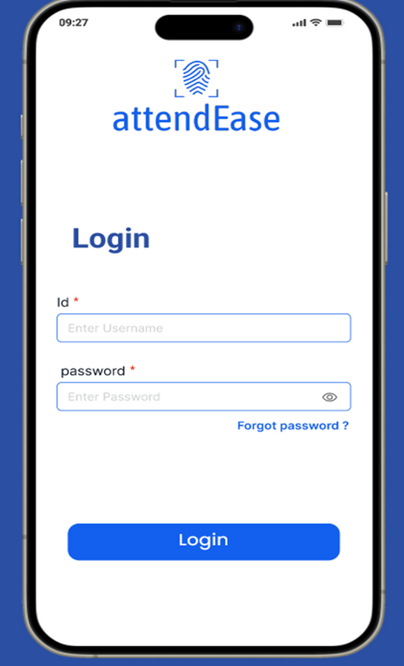
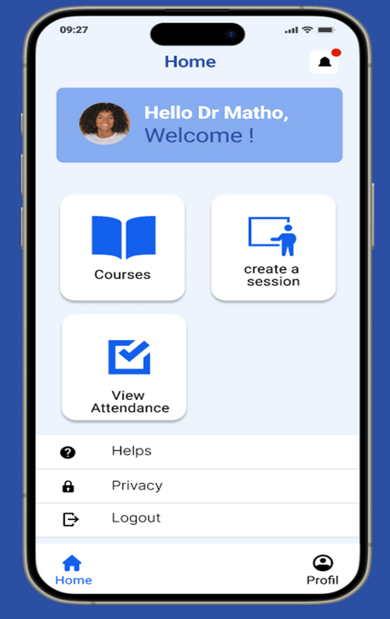
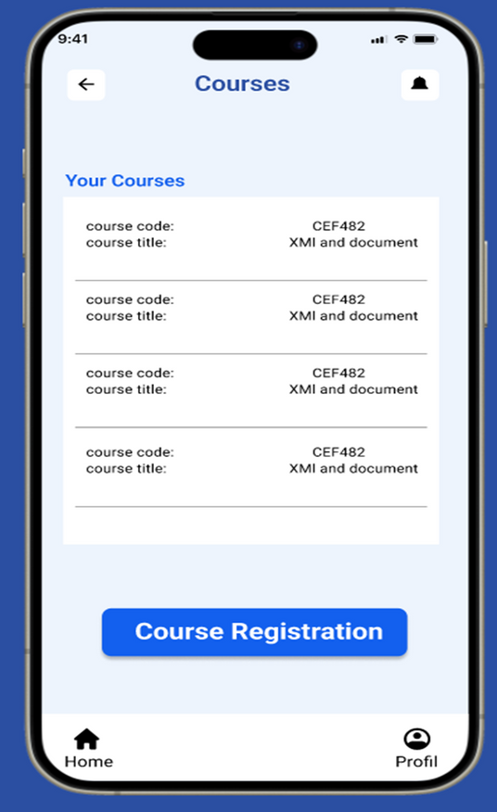
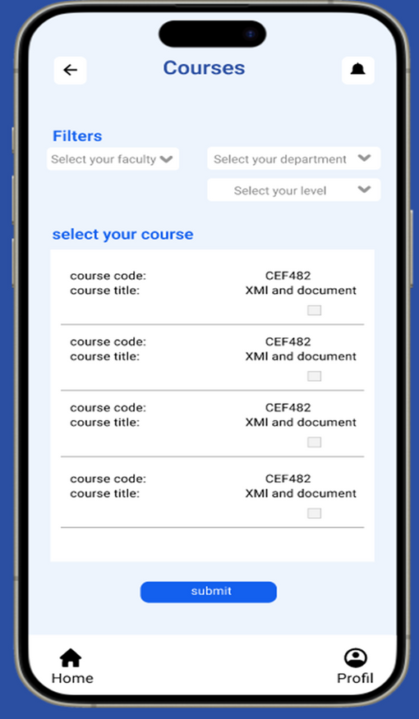
Instructor pages

Slide 22
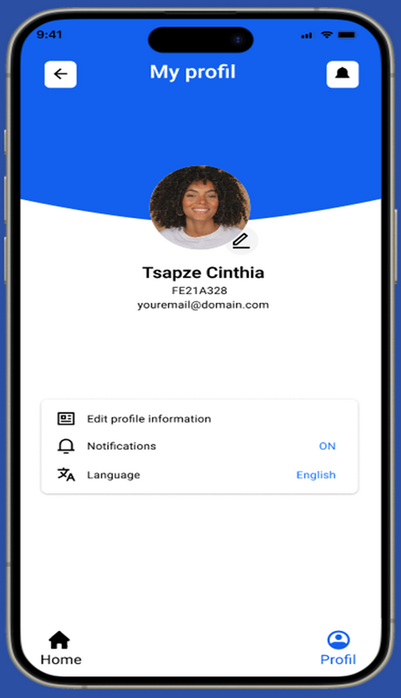
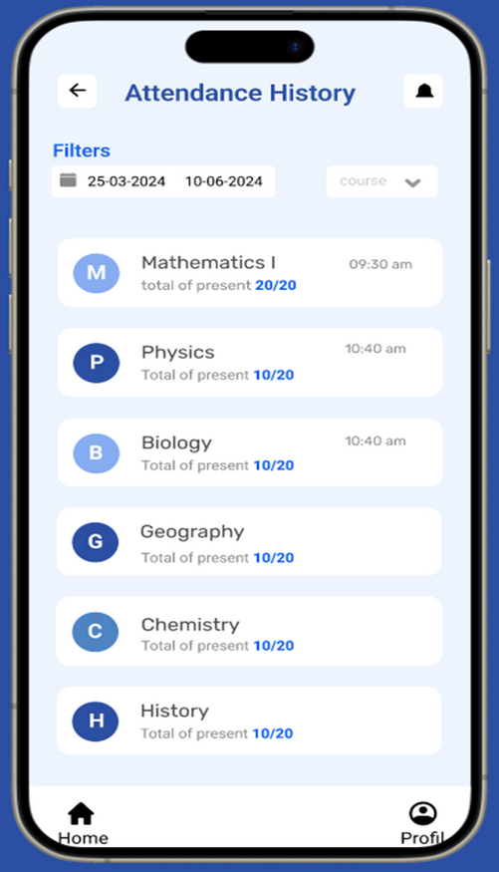
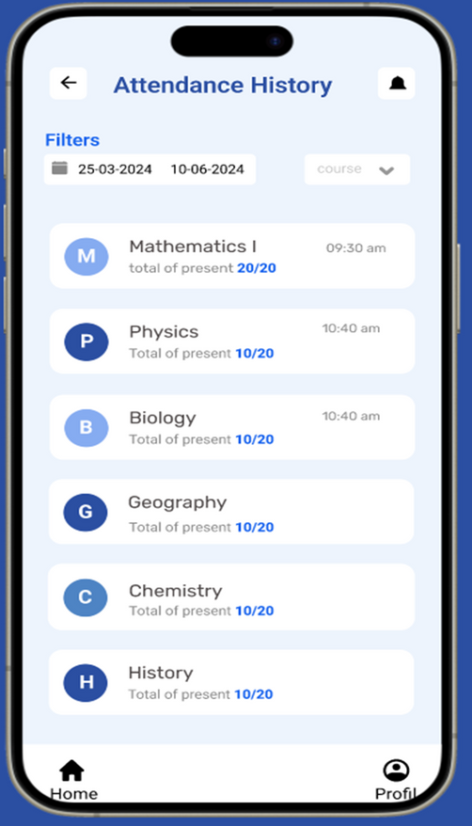
Attendance history

Slide 23
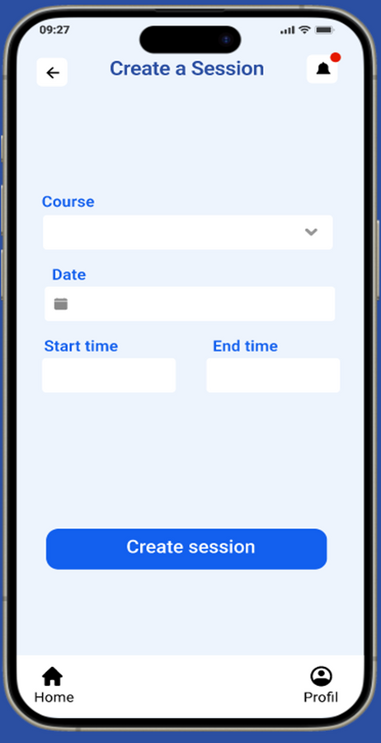
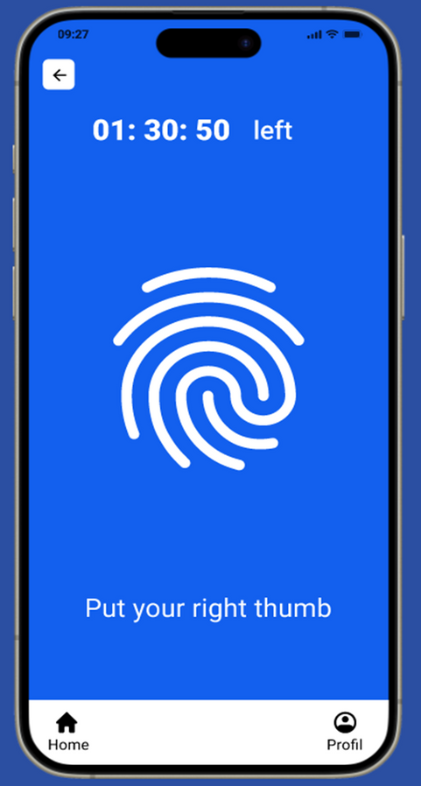
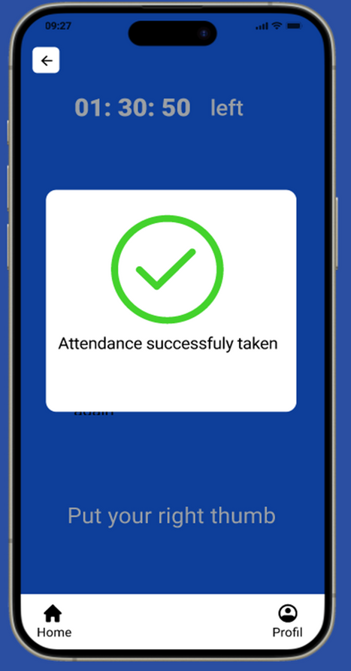
Attendance marking

Slide 24
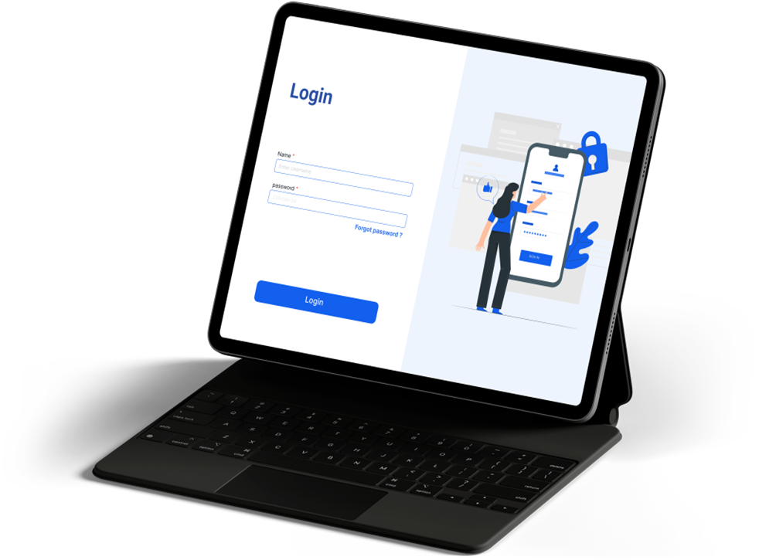

WEB DASHBOARD SCREENS
Admin add student
Admin login page

Slide 25
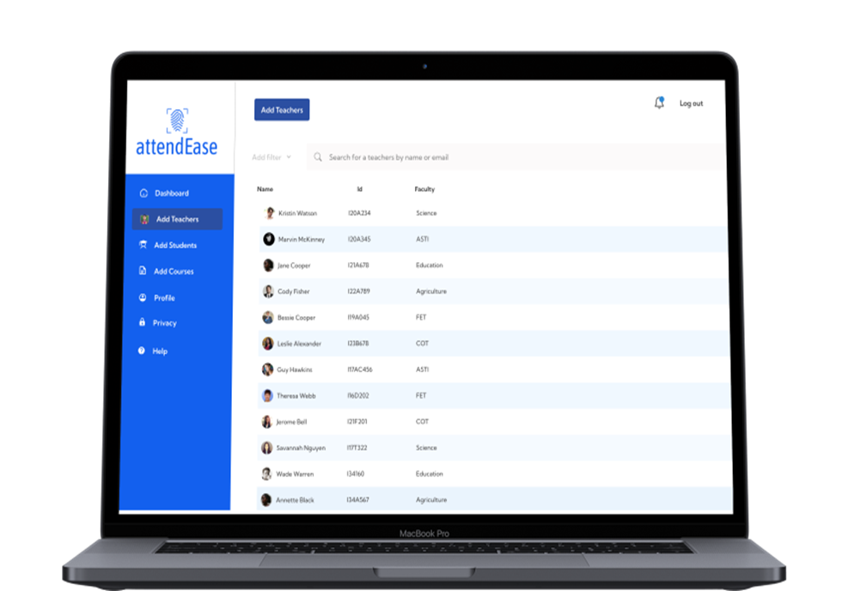
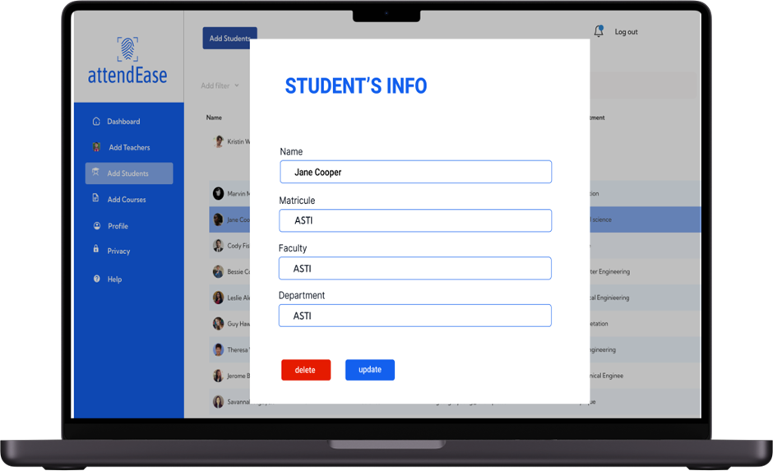
Student info
Admin add lecturer

Slide 26
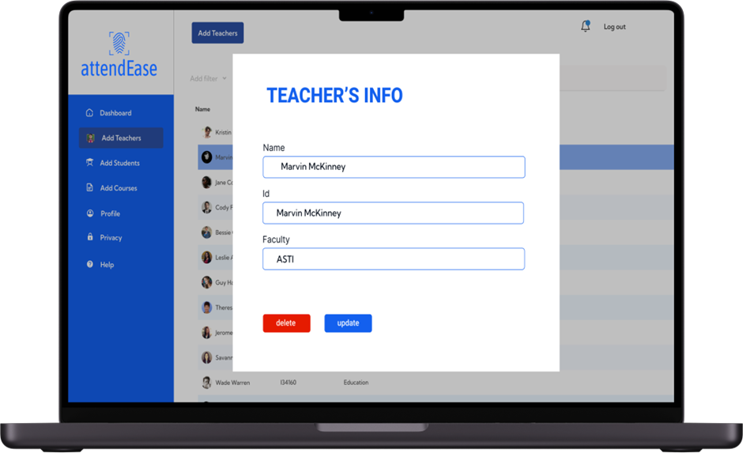
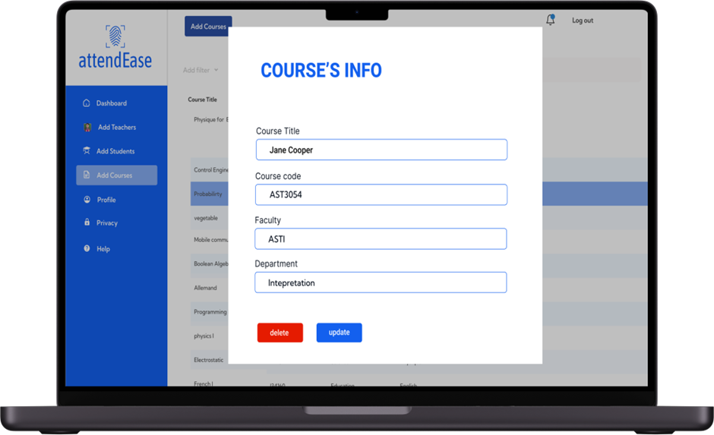
Lecturer info
Admin add courses

Slide 27
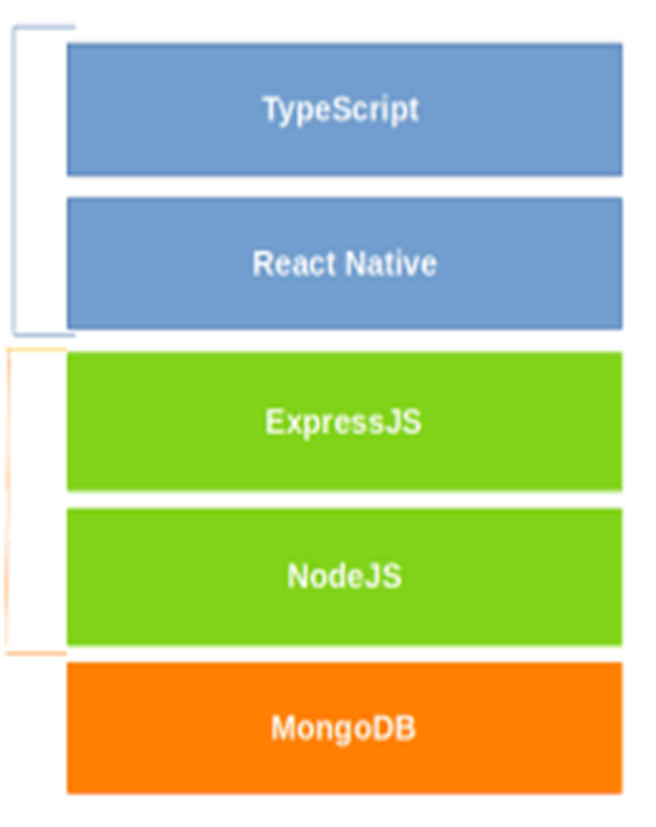
SYSTEM ARCHITECTURE
Frontend
Backend

Slide 28
. CHALLENGES AND RECOMMENDATIONS
Challenges
Hardware failure
Machines got bad during the coding environment set-up
Accurate Fingerprint Recognition
Developing a reliable fingerprint recognition system that works accurately across different devices and environmental conditions.
Handling Network Issues
Managing app functionality in environments with unstable or limited internet connectivity.

Slide 29
Recommendations
Further works
Machine learning algorithms
Pilot testing
User training
Biometric fusion
Scalability planning
Big data analytics
Privacy and data security
Cloud-based solutions

Slide 30
CONCLUSION
The Biometric Student Attendance Mobile Application is set to transform the way educational institutions manage attendance. By leveraging advanced fingerprint recognition technology, this app ensures accurate, secure, and efficient attendance tracking. Administrators, teachers, and students all benefit from its user-friendly features, real-time updates, and robust data security. This innovative solution not only streamlines administrative processes but also enhances the overall educational experience, making it an invaluable tool for modern educational environments

